Slide 1


SPEECH RECOGNITION WITH LLMS ADAPTED TO DISORDERED SPEECH USING REINFORCEMENT LEARNING
K.RAMAKRISHNAN COLLEGE OF TECHNOLOGY
(AUTONOMOUS), TRICHY
PRESENTED BY GUIDED BY
ARULHARI S -2403811724321009 Ms. ADEEBA AAISHA F
ARULRAJ D -2403811724321010 TA /AIDS
ASWATHI S - 2403811724322011
ATHIQUR RAHMAN M H- 2403811724321012

Slide 2
ABSTRACT
Automatic Speech Recognition (ASR) helps convert human speech into text. However, recognizing speech from people with speech impairments is difficult for traditional systems. This project uses a Large Language Model (LLM) to improve speech recognition by converting audio into tokens. The system is trained using fine-tuning and Reinforcement Learning from Human Feedback (RLHF). Word Error Rate (WER) and Meaning Preservation (MP) are used to evaluate the system. The proposed method aims to produce more accurate transcripts while preserving the original meaning of disordered speech.

Slide 3
OBJECTIVE
Enable LLM-based speech recognition.
Convert speech into audio tokens.
Improve recognition of disordered speech.
Preserve speech meaning during transcription.
Compare fine-tuning and RLHF methods.

Slide 4
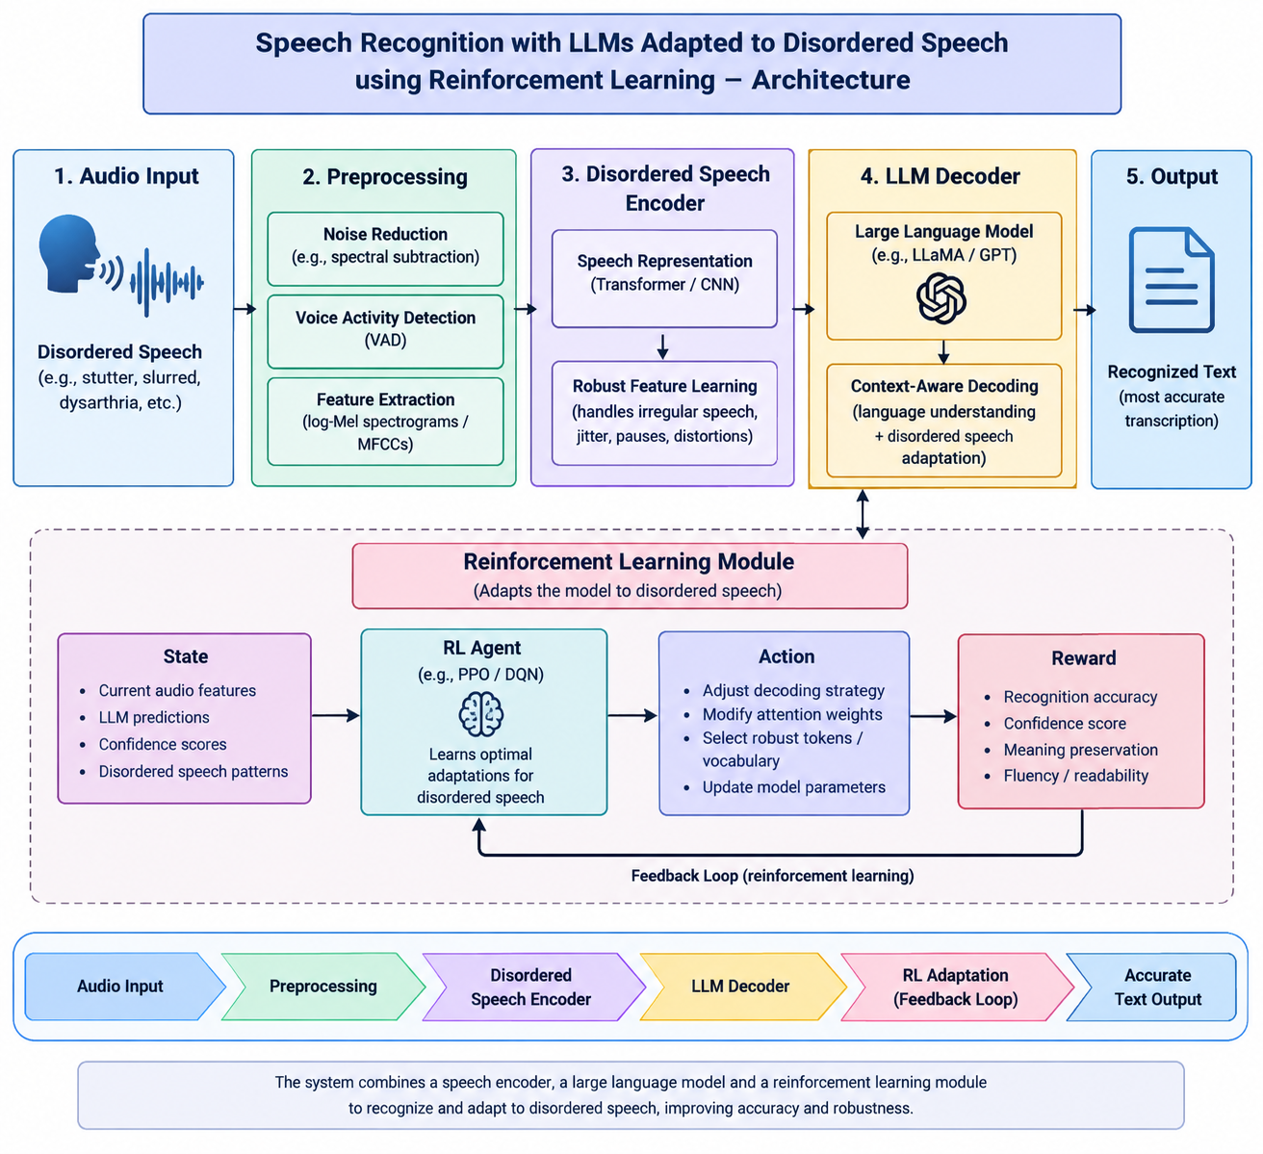
ARCHITECTURE DIAGRAM

Slide 5
LITERATURE SURVEY
"Speech_Recognition_Literature_Survey.xlsx"

Slide 6
RESEARCH METHODOLOGY
Module 1: Speech Input Acquisition
Collect speech from users.
Accept both normal and disordered speech.
Perform basic preprocessing and noise reduction.
Module 2: Audio Token Generation
Process the audio signal.
Convert speech waveform into audio tokens.
Prepare token sequences for the LLM.

Slide 7
RESEARCH METHODOLOGY
Module 3: LLM-Based Speech Recognition (Gemma 2B)
Map audio tokens to the LLM vocabulary.
Use Gemma 2B to understand speech context.
Predict words and sentences accurately.
Module 4: Fine-Tuning and Reinforcement Learning
Fine-tune the LLM using disordered speech datasets.
Apply Reinforcement Learning from Human Feedback (RLHF).
Improve transcription quality and accuracy.

Slide 8
RESEARCH METHODOLOGY
Module 5: Transcription Output and Evaluation
Display the final text transcription.
Compare output with reference transcripts.
Store results for analysis and improvement.

Slide 9
EXISTING SYSTEM
Focuses mainly on normal speech.
Relies heavily on WER evaluation.
Struggles with disordered speech.
Often requires architecture changes.
Shows limited domain adaptation.

Slide 10
PROPOSED SYSTEM
Uses Gemma 2B as the base model.
Maps audio tokens into the LLM vocabulary.
Retains the original LLM architecture.
Applies RLHF with WER and MP rewards.
Improves disordered speech recognition.

Slide 11
CONCLUSION
LLMs can perform speech recognition.
Audio tokens integrate effectively with LLMs.
RLHF improves adaptation performance.
Meaning preservation enhances transcript quality.
RLHF outperforms standard fine-tuning.

Slide 12
FUTURE ENHANCEMENT
Use larger LLM models.
Support multiple languages.
Improve audio tokenization methods.
Combine additional reward signals.
Enhance performance for severe disorders.

Slide 13
THANK YOU

